Slide 1
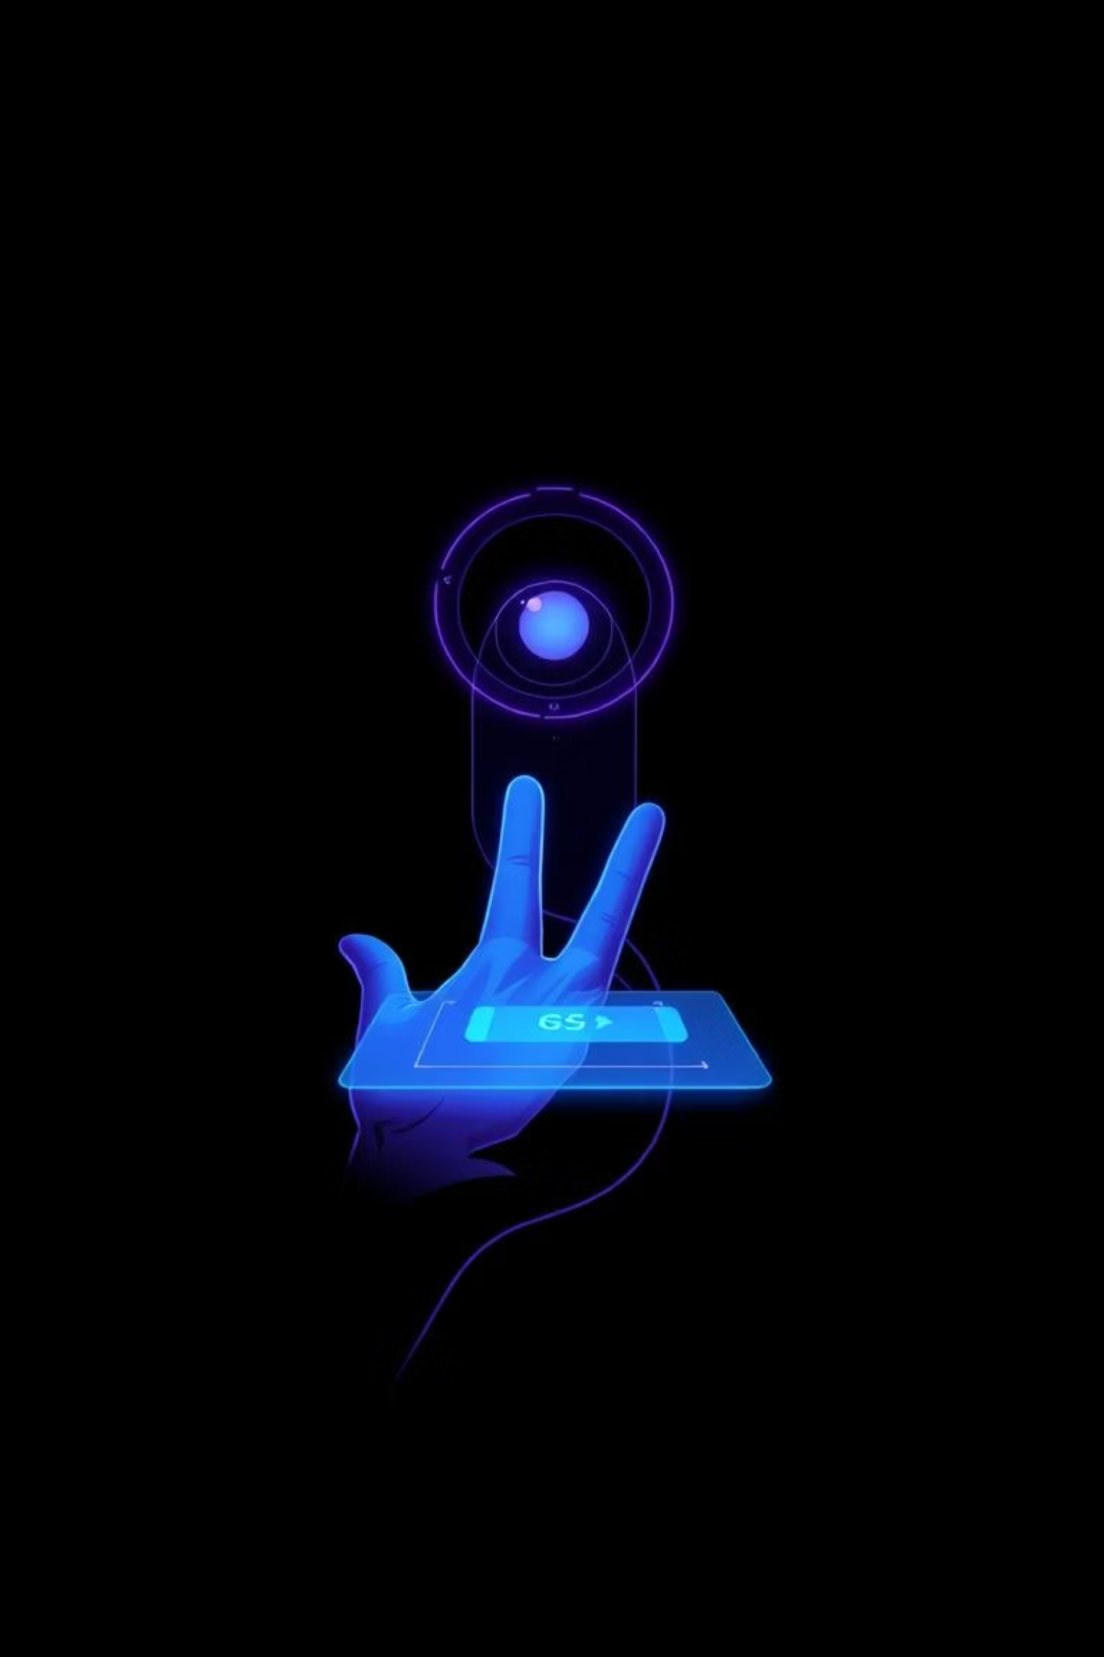
VISUALSENSE: Gesture-Controlled Console
Unlocking intuitive interaction with embedded IoT systems through innovative gesture control.

Slide 2

CHAPTER 1
The Challenge: Bridging the Physical and Digital Divide
Limitations of Traditional Input
Need for Intuitive Interfaces
Keyboards, mice, and touchscreens require physical contact, limiting their use in many IoT scenarios. This creates a barrier for seamless, touchless interaction.
There's a growing demand for touchless, intuitive interfaces that enhance user experience, especially in aesthetically pleasing or futuristic settings, without relying on expensive dedicated sensors.

Slide 3





CHAPTER 2
VisualSense Objectives: Building a Futuristic Console
Wireless Video Streaming
Real-time Computer Vision
Design a robust wireless video streaming system utilizing the ESP32-CAM module for real-time data capture.
Implement advanced computer vision algorithms using Python and MediaPipe to accurately track hand landmarks.
Bi-directional Control
Cloud Data Integration
Create a communication protocol enabling hand gestures to control both a web-based game console and physical hardware (LEDs, Relays).
Integrate Firebase for persistent data storage, supporting features like game leaderboards and security access logs.

Slide 4
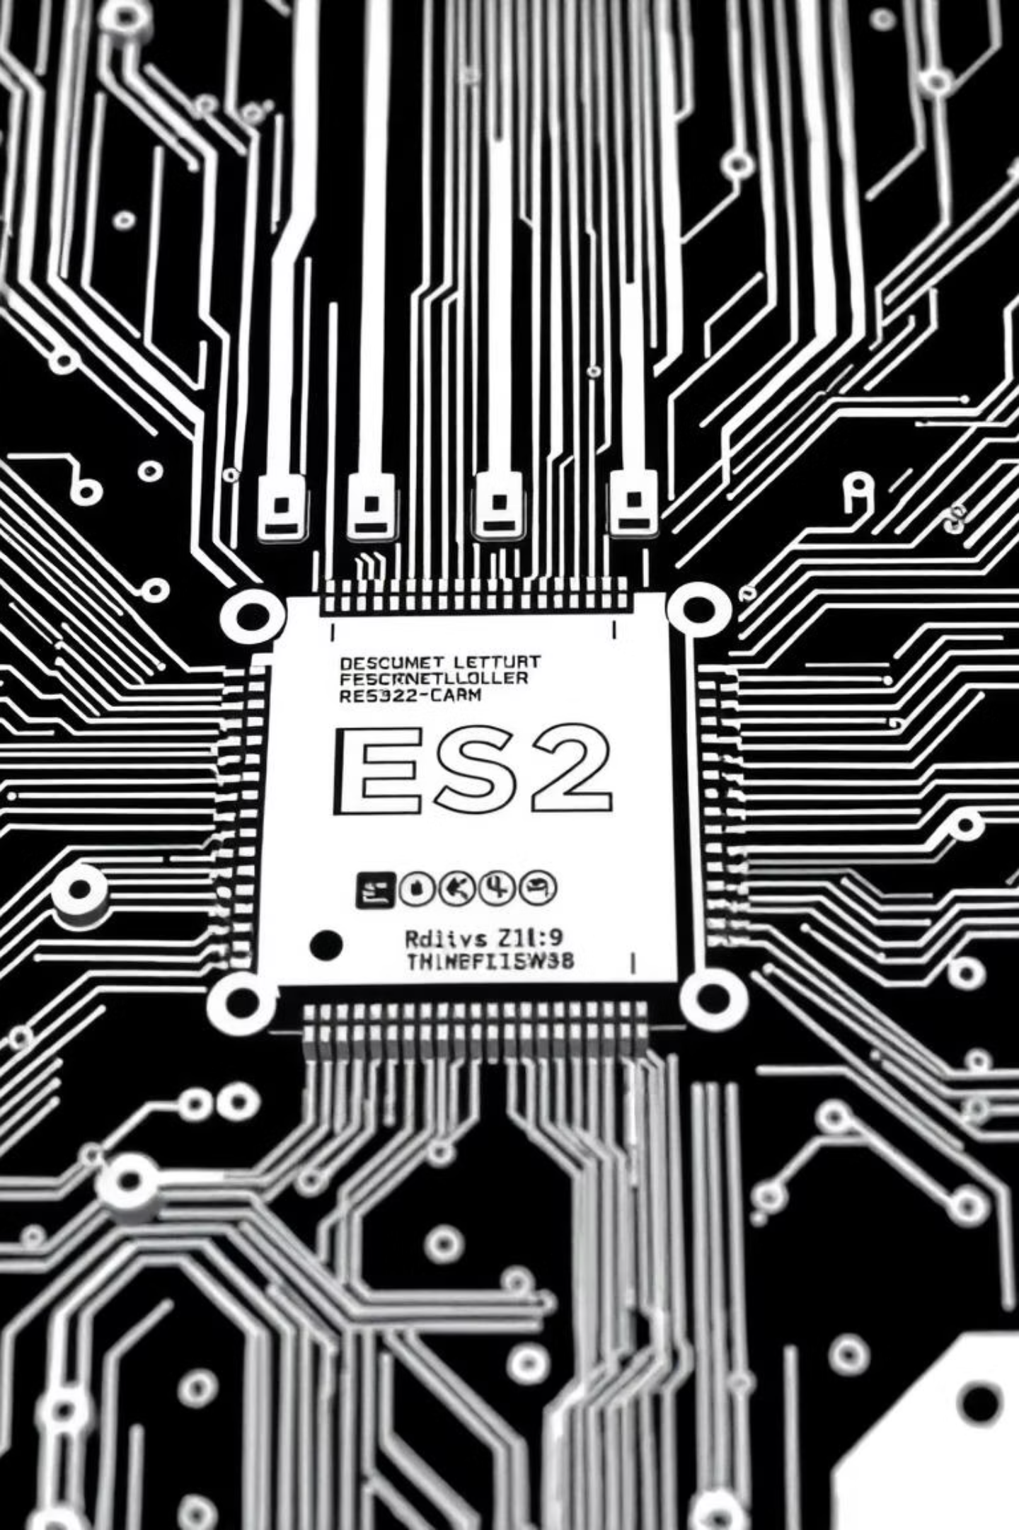

CHAPTER 3
System Architecture: Client-Server Model
Firebase
ESP32
Cloud database for state
Video server and actuator
Client-Server Flow
Web Browser
PC
Visual interface and game engine
Processing unit and gesture analysis
Our system leverages a robust client-server model for efficient processing and seamless interaction. The ESP32 handles video and physical actuation, while the PC processes the video feed for gesture recognition. The web browser serves as the dynamic visual interface and game engine, all backed by Firebase for data persistence.

Slide 5





CHAPTER 4
Hardware Deep Dive: The Foundation of VisualSense
ESP32-CAM (AI Thinker)
OV2640 Camera Module
FTDI Programmer
The brain of our system, managing Wi-Fi connectivity and high-resolution video capture.
A 2MP sensor providing the visual input necessary for gesture detection.
Crucial for flashing firmware onto the ESP32-CAM, ensuring proper device operation.
LED & Resistor
Relay Module
Connected to GPIO 12 for demonstrating PWM dimming, controlled wirelessly by gestures.
Linked to GPIO 13, enabling security access control features like 'Unlock mode'.

Slide 6
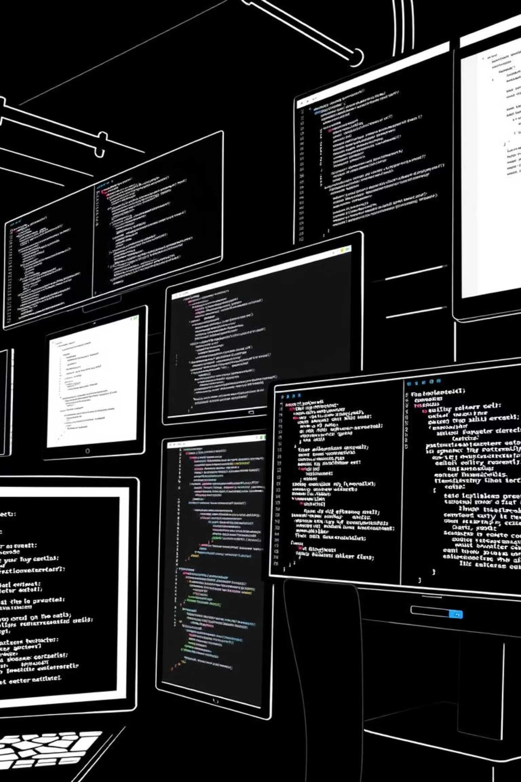
CHAPTER 5
Software Stack: Powering Intelligent Interaction
Embedded & Backend
Frontend & Database
Arduino IDE: For C++ firmware (Hand_Tracking.ino), handling web server, camera config, and UDP.
OpenCV: Essential for image processing, frame manipulation, and HUD overlays.
Python 3.x: Powers the backend script (esp_script.py) for heavy lifting.
Web Technologies: HTML5, CSS3 (Cyberpunk aesthetic), and JavaScript for intuitive game logic.
MediaPipe: Google's framework for efficient, real-time hand tracking and landmark detection.
Firebase: Google's cloud database for persistent storage of high scores and security logs.
WebSockets: Enables low-latency communication between Python and the web interface.

Slide 7
CHAPTER 6
Methodology: From Firmware to Command
01
02
03
Firmware Deployment
Stream Acquisition
Gesture Processing
ESP32 connects to Wi-Fi, serving HTML on Port 80 and the raw MJPEG video stream on Port 81.
The Python script fetches and decodes video frames from the ESP32 using OpenCV.
Each frame is analyzed by MediaPipe to extract 21 hand landmarks if a hand is detected.
04
05
Logic Calculation
Command Transmission
Hand positions (Snake/Tetris), finger distances (Knob), and extended finger counts (RPS) determine commands.
Game commands are sent via WebSocket to the browser, while hardware commands use UDP to the ESP32 for minimal latency.

Slide 8
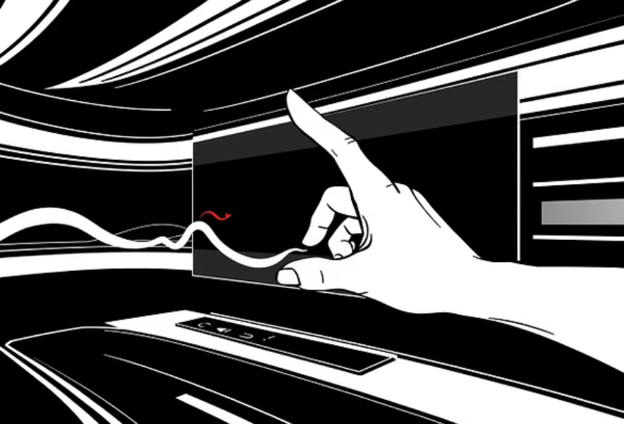
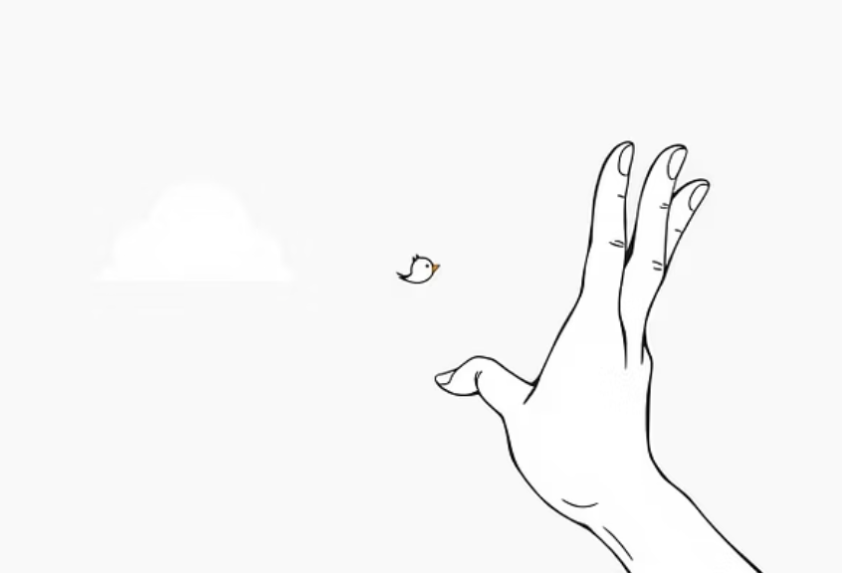

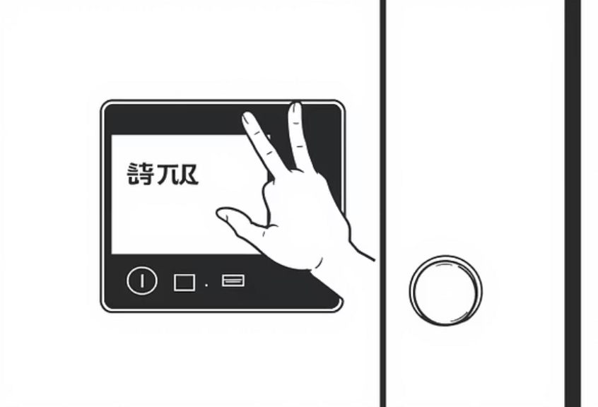


CHAPTER 7
VisualSense in Action: Diverse Applications
From classic games like Snake and Tetris to practical applications like smart home control and security, VisualSense offers a wide array of interactive modes, all powered by intuitive hand gestures.

Slide 9

CHAPTER 8
Key Achievements and Robust Performance
Eight Operational Modes
Successfully integrated diverse functionalities, proving versatility for both entertainment and automation.
Suitable Frame Rate
Achieved responsive interaction for casual gaming and precise hardware control.
Smooth LED Dimming
The "Knob" mode showcases effective gesture-based PWM control with a custom smoothing algorithm.
Firebase Integration
Reliable logging of "Door Unlock" events with timestamps, fulfilling critical security requirements.
VisualSense demonstrates the power of combining standard embedded hardware with modern computer vision, creating a robust, touchless console.

Slide 10
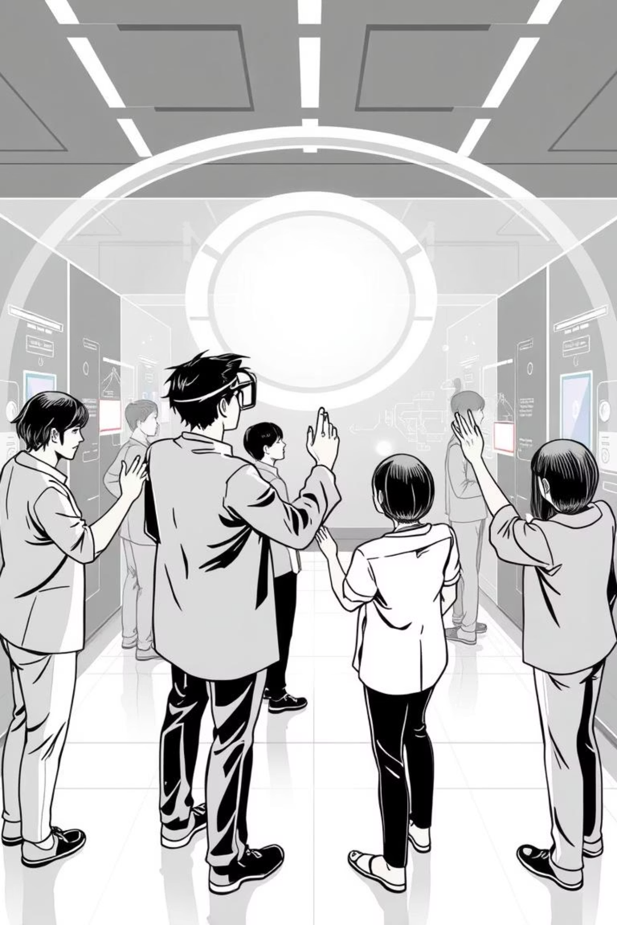

CHAPTER 9
Future Horizons: Expanding VisualSense
On-Chip Processing
Explore porting hand detection to ESP32-S3/Raspberry Pi with AI acceleration, reducing reliance on a PC backend.
Voice Integration
Adding voice commands to seamlessly switch modes or control games alongside existing gestures.
3D Navigation
Enhancing gesture logic to support depth-based movements (Z-axis) for richer, more complex interactions.
Multi-Hand Support
Developing logic for simultaneous detection of both hands, opening doors for two-player games and advanced control.

